Slide 1
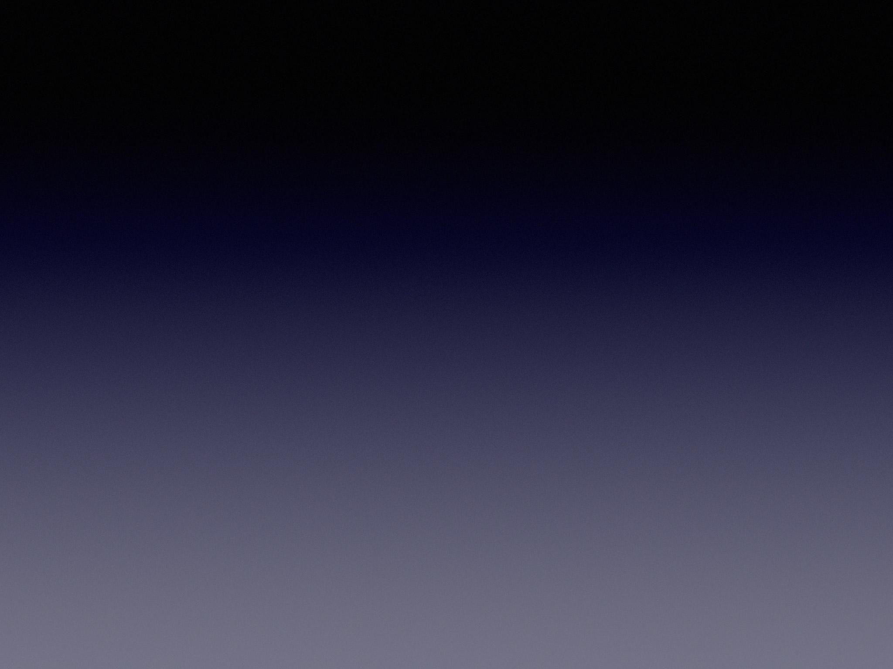
Symmetry
Visual Perception

Slide 2
What do you think symmetry is?
What types of symmetry do you think there are?

Slide 3
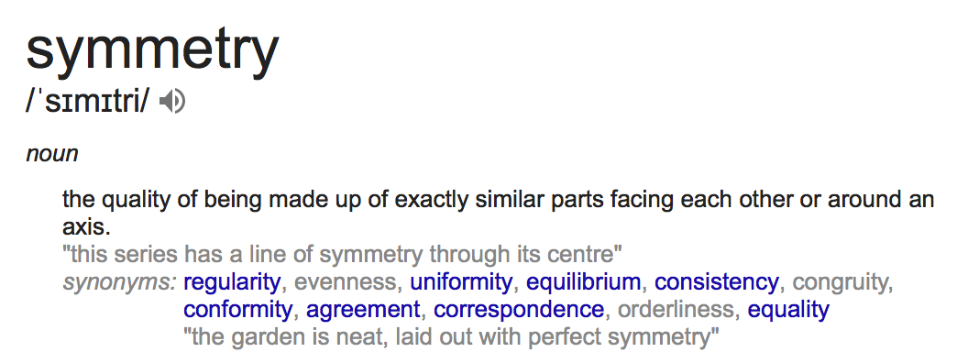
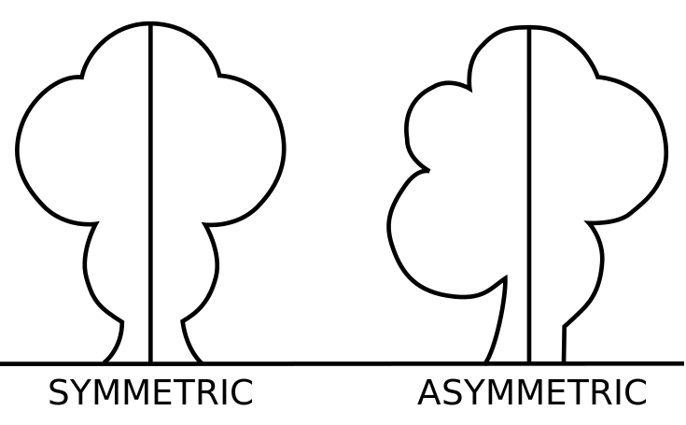
What is Symmetry?..
Symmetry is when one shape becomes exactly like another if you flip, slide or turn it. There are three types of symmetry, rotational, horizontal and vertical.

Slide 4
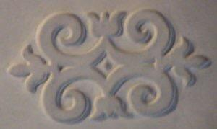
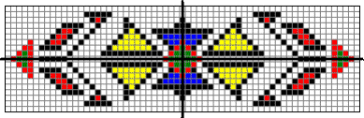
Two lines of Symmetry
Here are examples images that has a horizontal and vertical lines of symmetry.

Slide 5
Further…
https://www.youtube.com/watch?v=uamFhrP-Su0

Slide 6


Ian Stewart discusses history of symmetry
https://www.youtube.com/watch?v=eot5Vy1lZnY

Slide 7
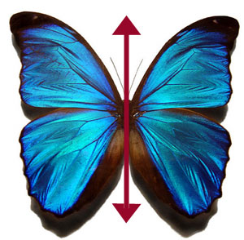
Ian Stewart - A History of Symmetry
Discusses the importance of symmetry and its relationship with how we perceive and build the world around us

Slide 8
Symmetry in web design
Symmetrical design relies on principles of balance, rhythm, proportion and unity to create a style with mirroring sides. Symmetry happens when the composition of design is distributed evenly around a central point or axis. This symmetry can be horizontal, vertical or radial in form.

Slide 9
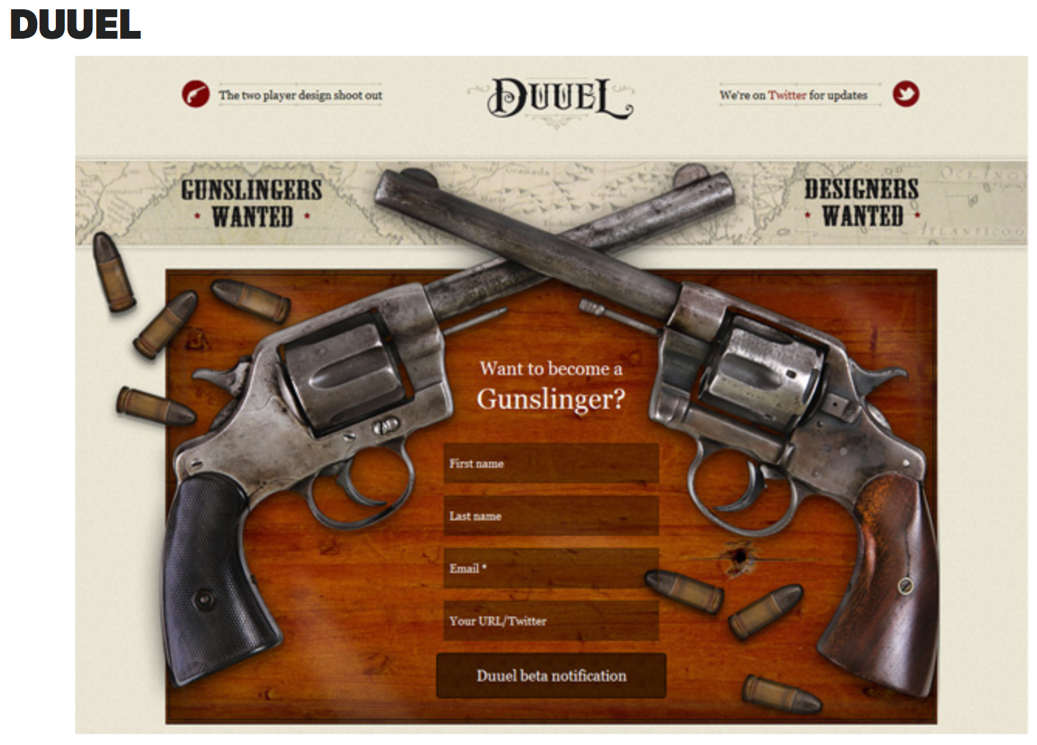
Symmetry in Web design
In design, symmetry is closely tied to balance. A perfectly symmetrical design achieves balance and a sense of stability.

Slide 10
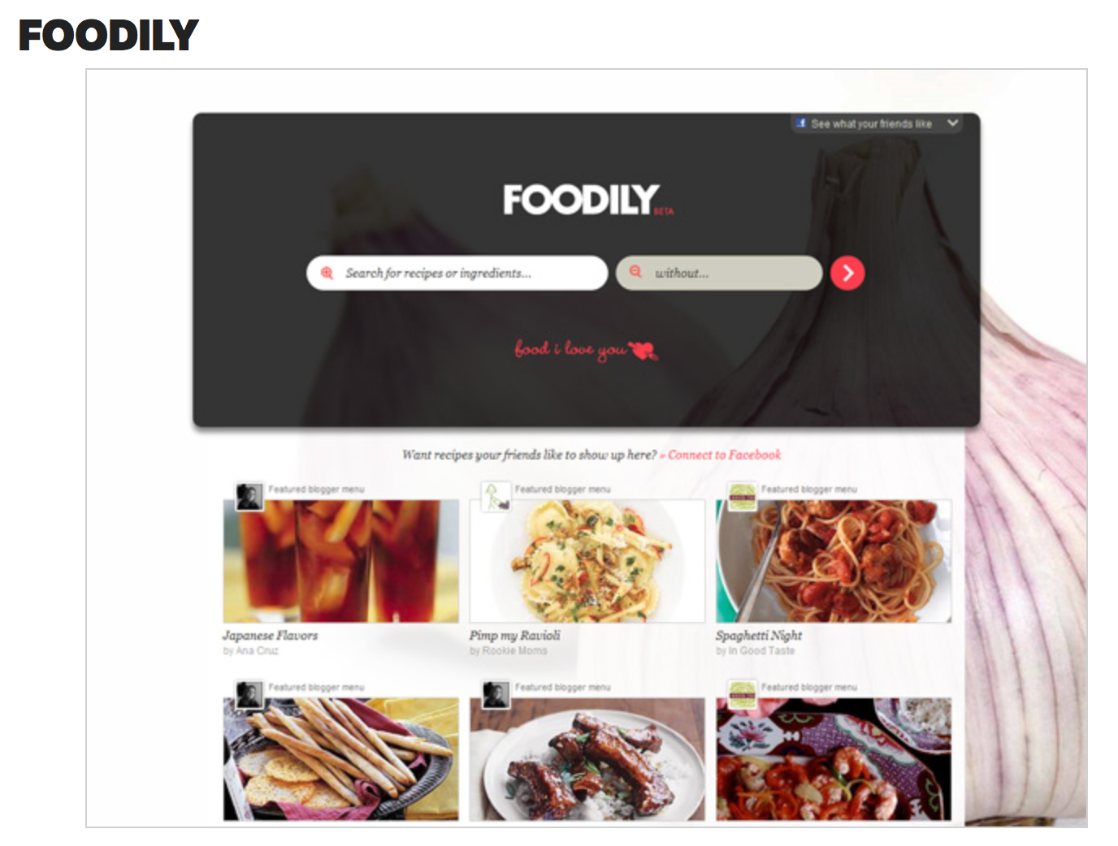
Example
Symmetry is also useful for keeping clutter out of a design. While this is not reason alone to use it, Foodily does make a strong case for it, with its clean and elegant layout. While most recipe websites overflow with content, this one is remarkably simple.
The pictures if the different dishes are positioned side by side following a coordinated design which makes the website look simple and easy to look at.

Slide 11
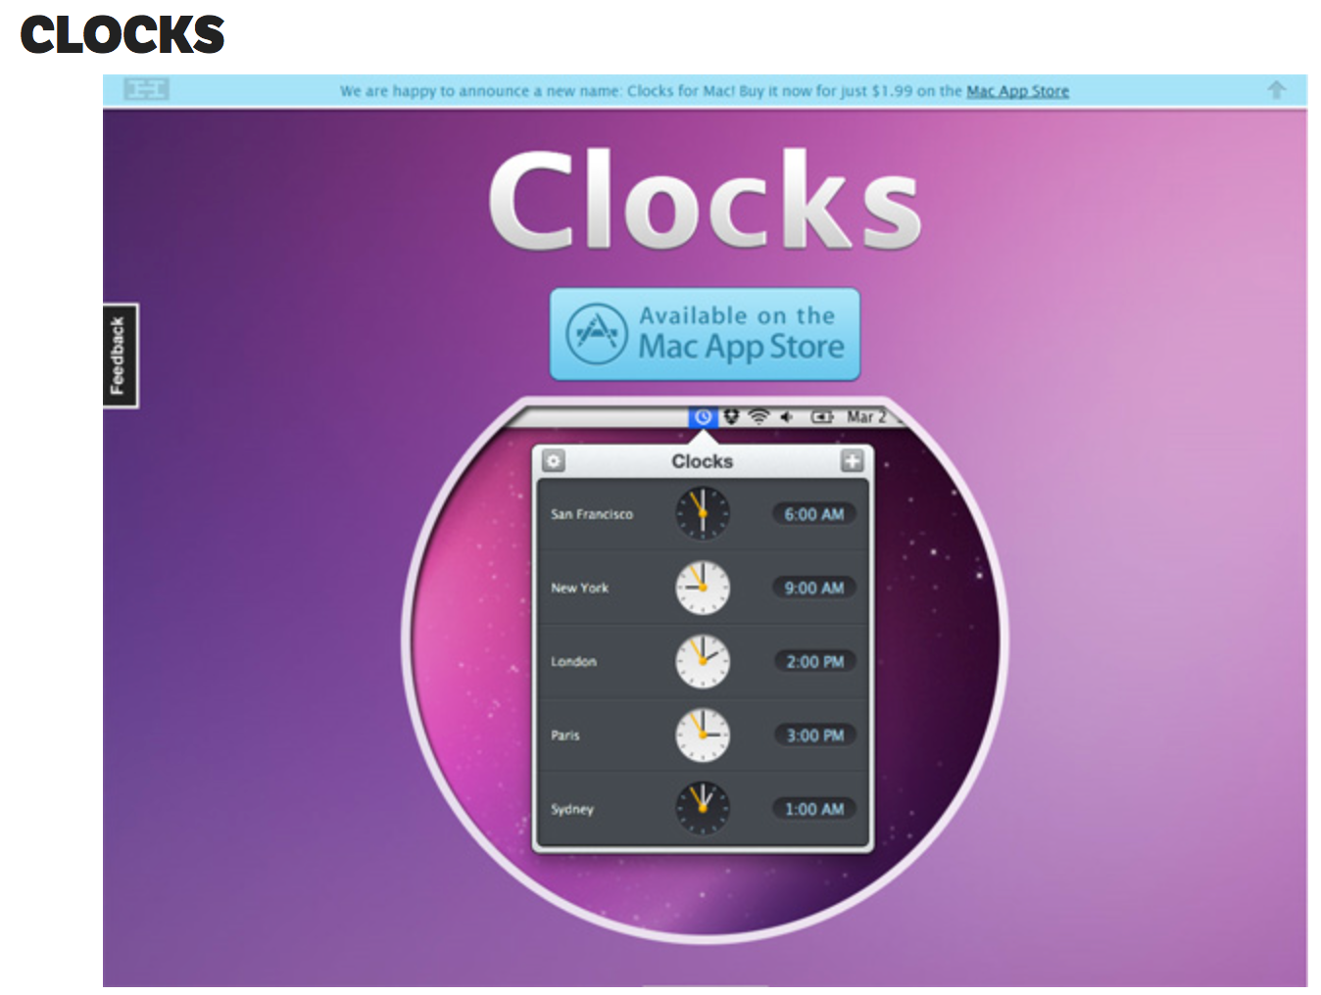
Example
Symmetry is also great when you simply don’t have much to say. The makers of Clocks don’t need much to explain their product
Clocks have a symmetrical design therefore it is ideal for this website to use it.

Slide 12
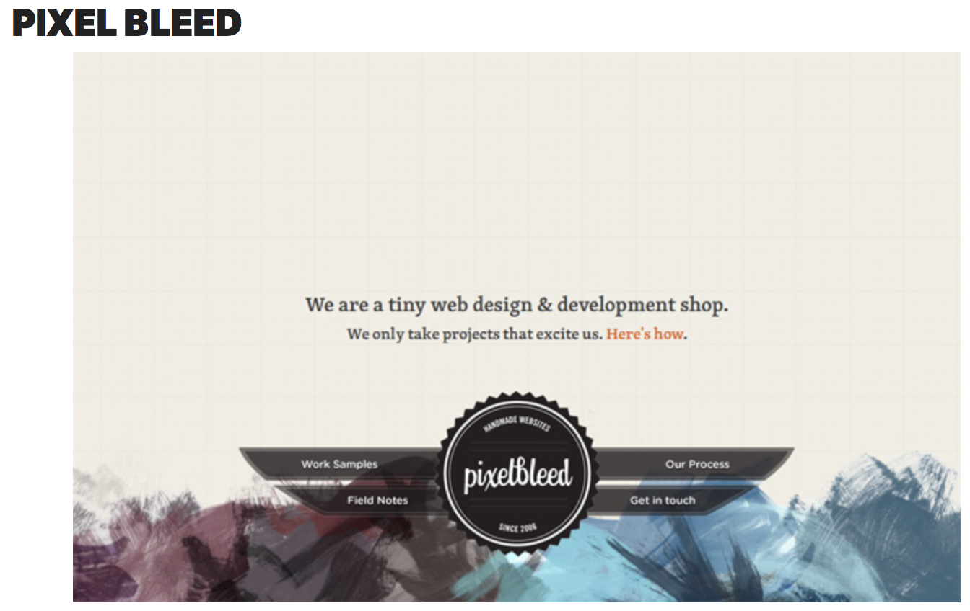
Example
The layout and design of this website does not follow the norm of website designs as the logo and navigational buttons are placed on the bottom. HOWEVER the symmetry lends an interesting balance to the design. And with the visually heaviest elements at the bottom of the page, the layout feels grounded.

Slide 13
Do visitors' interest level and perceived quantity of web page content matter in shaping the attitude toward a web site?
A study was undertaken which examines how the amount of content on a web page and how it was presented impacted the visitors attitude and interest level.
This Research consisted of three main studies.
The effects of informativeness, entertainment and ease of navigation were tested and verified.
The results
-The websites with less information that was organised in a symmetrical layout gained more interested visitors
-Websites that had larger amounts of unorganised information lost visitors quicker
A A

Slide 14
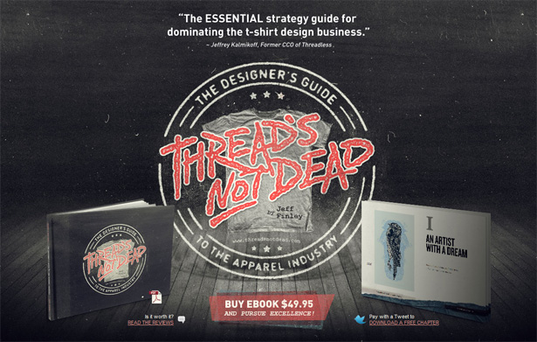
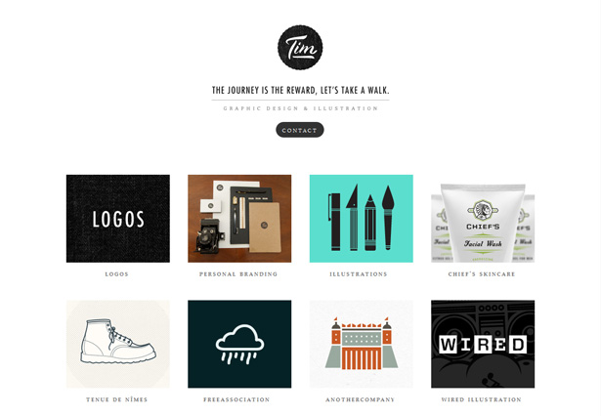
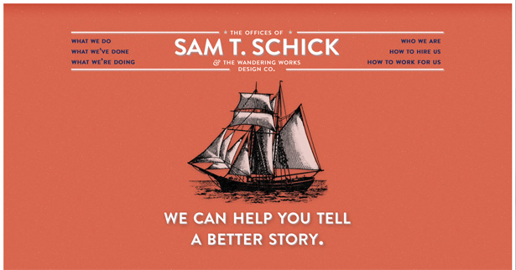
The way you design in a website influences how the information is perceived.
The way information is presented on a page
Entertainment quality of content
Ease of navigation

